Slide 1
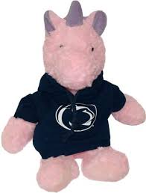



Title sub-Title
Team member 1
(aka pink Keras)
Team member 2
(aka overfitting)
Team member 3
(aka always late)
Team member 4
(aka softmax)
Design and Implementation of AI System (Fall/SP/SU, 202x)
Dr. Youakim Badr
The ”aka” are optional :).
I add them just for fun..
If you decide to add your aka, please be respectful and choose something related to your personality or your role in this project.
PS: remove this call out ;-)

Slide 2
2 min to convince the audience
Context, Problem, teasing about the solution

Slide 3
Context and Introduction

Slide 4
Problem and Challenges

Slide 5
Related solutions / State of Art

Slide 6
Overview of Solution / Contributions

Slide 7
Data Collecting

Slide 8
Data Preprocessing

Slide 9
Methodology
…

Slide 10
Models selection and parameters
Normalization, regularization, data augmentation, layers, activation functions, Tuning,

Slide 11
Network Training – validation - testing

Slide 12
Evaluations – Performance – comparing
Baseline models

Slide 13
Outcomes/finding

Slide 14
Lessons learned and Perspectives

Slide 15
Bibliographical References

Slide 16
Demo !

Slide 17
Backup slides

Slide 18
Video

